Slide 1
Final Presentation
Rents Prediction Model Based on House Attributes and Public Transportation Accessibility
Group 18: Yijing Zhou & Jiachen Huang

Slide 2
AGENDA
1
2
3
4
Result & Future Work
Introduction
Data & Feature
Methodology

Slide 3
01
Introduction
Project Goal:
Develop a model that can predict the rent, given house attributes and the accessibility to public transportations.
•Predict the fair rent of an apartment
•Suggest on public transportation planning
•Find undervalued units

Slide 4
01
Introduction
Significance:
9.6 million migrants in Shanghai, 80% rent their house
Helped assess fair rent price and find undervalued units
Source: Sadayuki, Taisuke. “Measuring the Spatial Effect of Multiple Sites: An Application to Housing Rent and Public Transportation in Tokyo, Japan.” Regional Science and Urban Economics, vol. 70, 2018, pp. 155–173., doi:10.1016/j.regsciurbeco.2018.03.002.
Notes:
The significance of our project lies in that there are around 9.6 million migrants in Shanghai right now and 80% of them choose to rent a house. Also, it’s important to help assess fair price for them so that they could make better decisions.

Slide 5
02
Data & Features
Data Source:
ganji.com
Web Crawler to download, regular expression and get dummies to process
MetrodataTeam’s city database
Import ArcGis data and transform into public transportation attributes
Notes:
Our data source is mainly composed of two parts. First, we got all the housing data from ganji.com, which is a leading online rental platform. We used web crawler to download data, and use regular expression and get dummies to preprocess it. Our second data source is MetrodataTeam’s city database. We import Arcgis data and transform it into useful public transportation attributes.

Slide 6
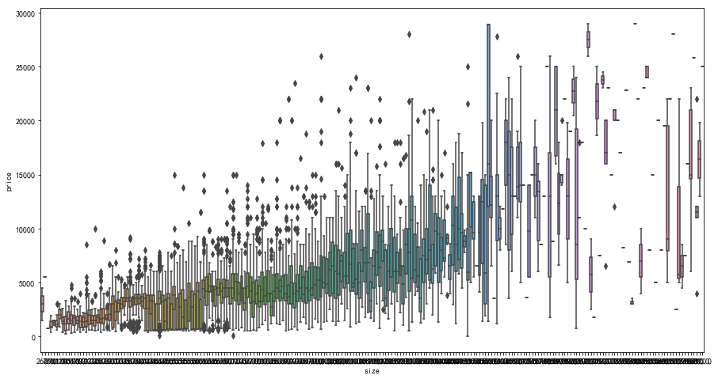
02
Data & Features
Notes:
Here we can see a plot that present the size and price of all units. From left to right, the price size relationship generally has a reasonable pattern until size is very large, and the variance becomes crazy

Slide 7
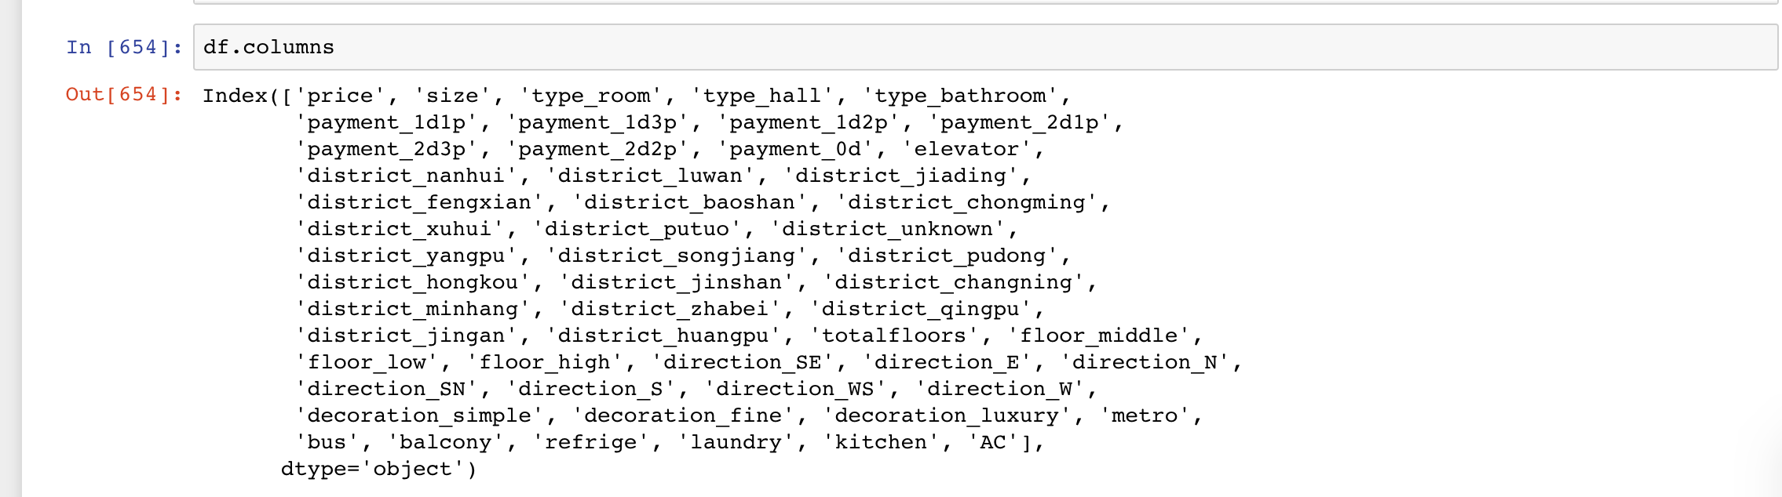
02
Data & Features
Features:
Size, Room type, Payment, District, Floors, Direction, Facilities, Decoration, Bus and Metro stations nearby...
Notes:
We can see there are many attributes after we process the data from raw text to numeric data. House features, such as size, type, payment method, district etc. Also, bus and metro accessibility is included.

Slide 8
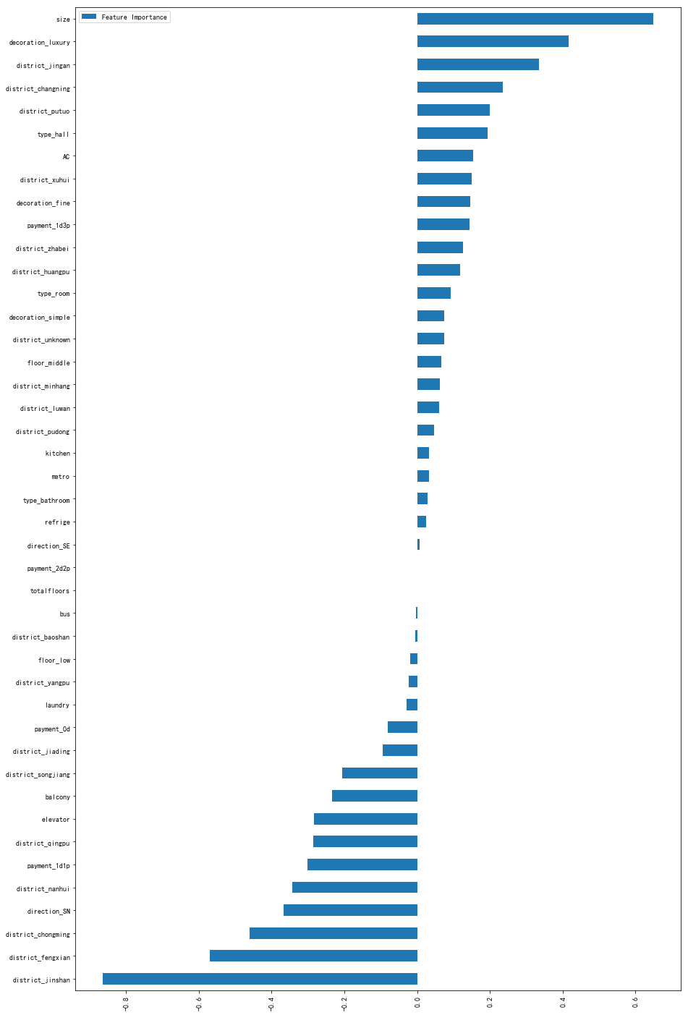
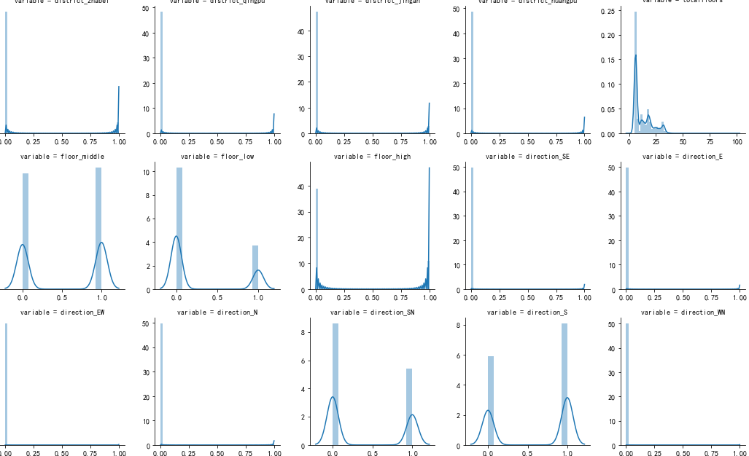
02
Data & Features
Skewness & Logarithm
LASSO
Notes:
Then we test the skewness of all variables. First we take log of size and price, to make sure errors in predicting expensive apartments and cheap apartments will affect the result equally. Also, by calculating the skewness of variables, we removed a few attributes data points with extreme skewness. For example, only 3 apartments, there is zero deposit and the rents are only paid once a year. So we remove these rare cases. On the right side, we apply lasso to figure out the importance of attributes. Combine the result with other reasoning, we can add some interaction terms in the model to improve the prediction power.

Slide 9
03
Methodology
Baseline and Evaluation Metric
Regression Models
Hyperparameters Tuning
Ensemble Methods
1
2
3
4

Slide 10
03
Baseline and Evaluation Metric
Baseline: Linear Regression
Evaluation Metric: Rooted Mean Square Error (RMSE)

Slide 11
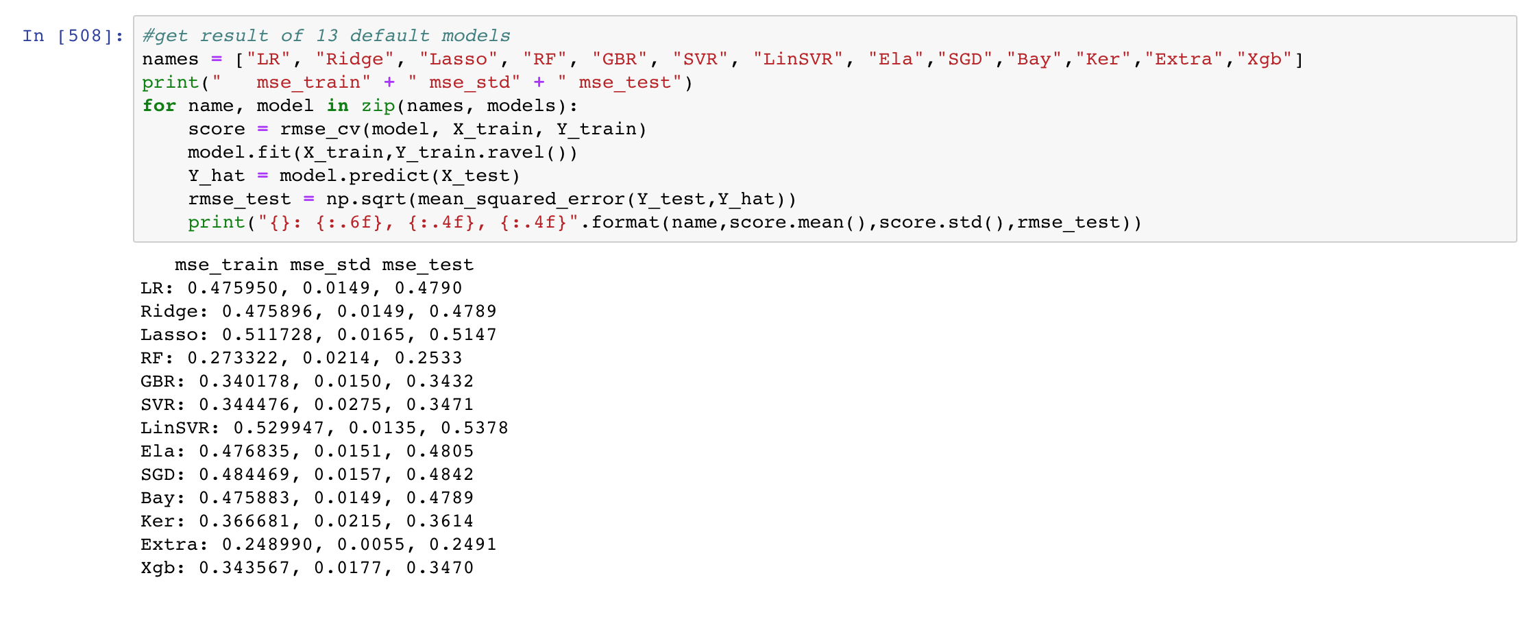
03
Regression Models
Notes:
Firstly, we choose several commonly used regression algorithms, to briefly test their prediction power and choose best ones among them into the next stage.

Slide 12
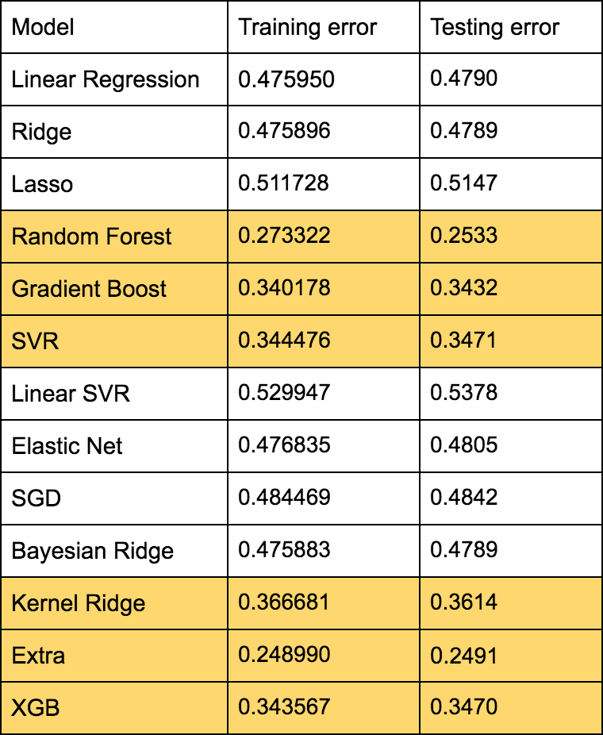
03
Regression Models
Notes:
These 13 models are all default models. We chose the models with errors below 0.4 and these models are highlighted here. Among them, the extratrees model have the lowest training and testing error.

Slide 13
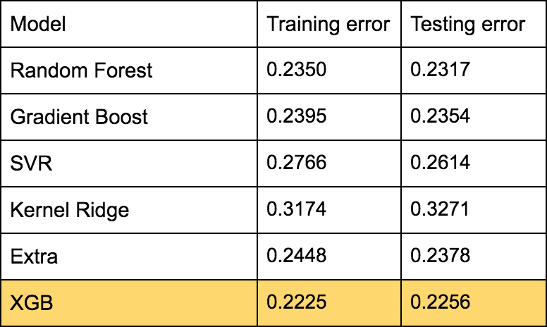
03
Hyperparameters Tuning
Grid Search VS. Random Search...
Notes:
We chose the six models above to move on to hyperparameters tuning. Here you can see that XGB gives the best performance, with an RMSE of 0.2225. If you compare the number with the previous page, you will find that this number is much lower. Also, we intend to try both grid search and random search, but grid search is very time-consuming so we choose random search instead.

Slide 14
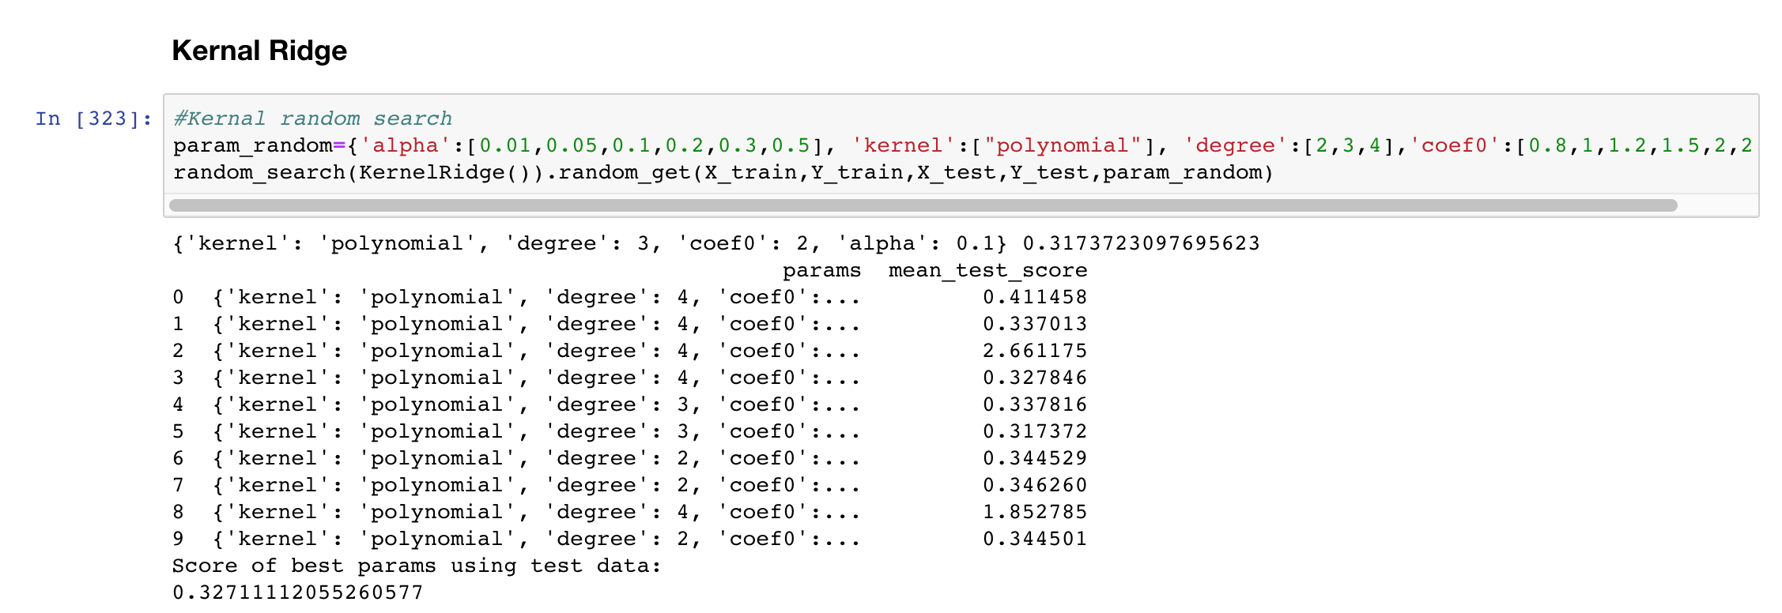
03
Hyperparameters Tuning
Grid Search VS. Random Search...
Notes:
Take the Kernel Ridge as an example, if we use random search, it takes about ten or twenty minutes to tune.

Slide 15
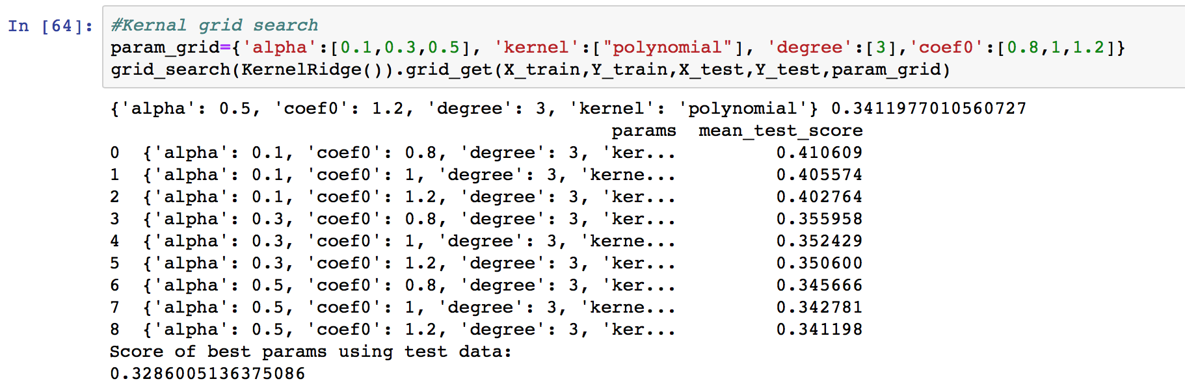
03
Hyperparameters Tuning
Very time-consuming
Notes:
However, if we use grid search, it becomes very time consuming and may even cost hours to get the result. And the tuning result differs only a little. So we use random search to conduct all further steps to save some time.

Slide 16
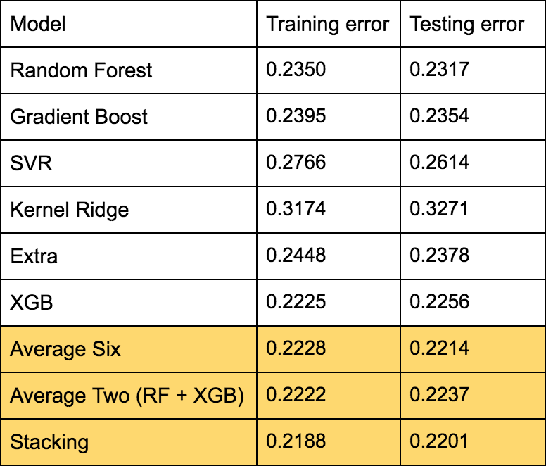
03
Ensemble Methods
Notes:
After tuning hyperparameters for each individual model, we also try three ensemble methods. The first one is weighted average of all the six models above, we assign each model a certain weight according to their performance. The second method is to choose the best two models -- Random Forest and XGB and assign each one with weight of 0.5. The third method is stacking. We used Kernel Ridge as the meta model and this stacking model gives the best RMSE of below 0.22.

Slide 17
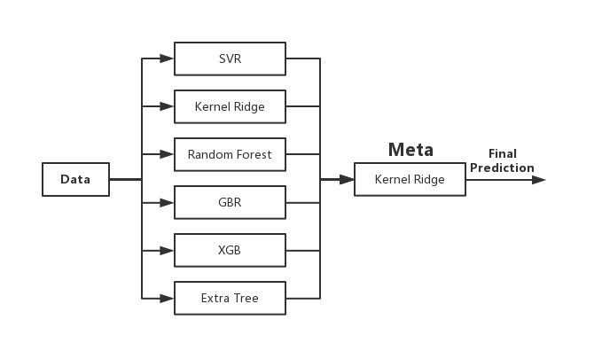
03
Ensemble Methods
Notes:
This is the diagram of our stacking model. We use Kernel Ridge as the meta model.

Slide 18


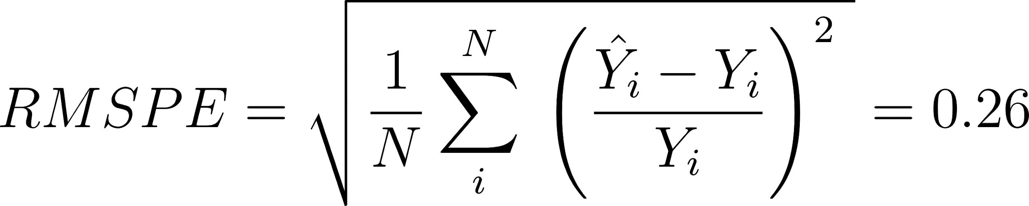
04
Result & Future Work
Notes:
Compared to baseline, improvement
RMSE cannot be compared across dataset, so also compute RMSPE to give a straightforward impression

Slide 19
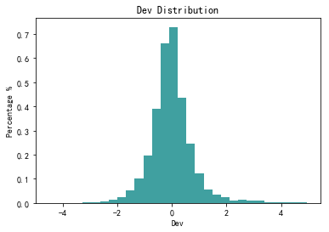
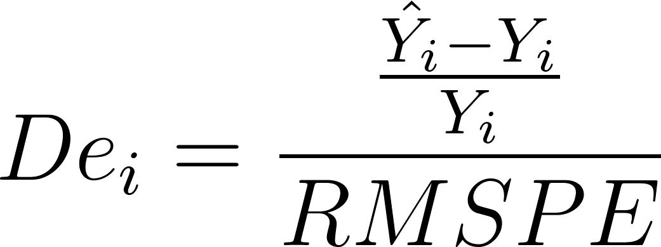
04
Result & Future Work
Deviation and Undervalued Units
Demo...
Notes:
Also, construct a deviation indicator. Very close to Standard Normal distribution, mean 0.05, standard variance about 1.02

Slide 20
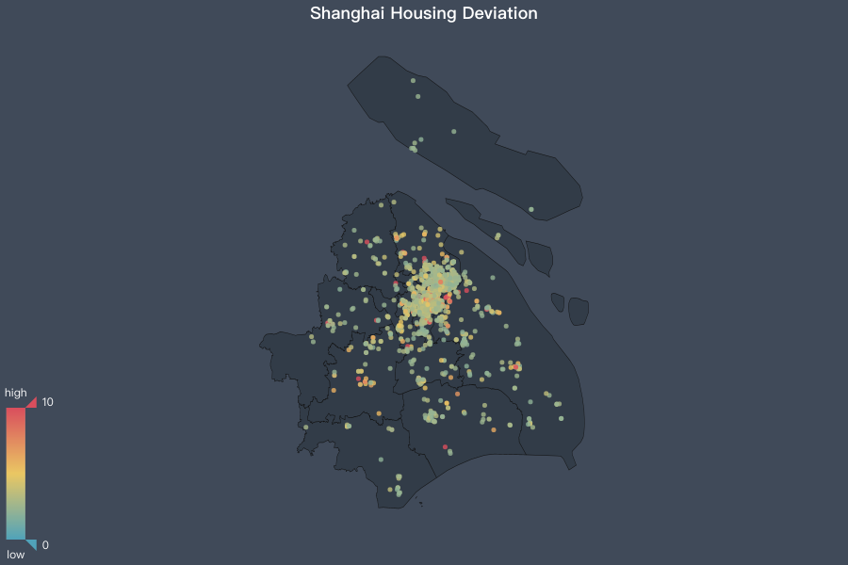

Slide 21
04
Future Work
More features and data points;
Cross-sectional to Panel Data;
Parameter tuning for the stacking model;
Do different cities, compare housing price with rental price…...

Slide 22
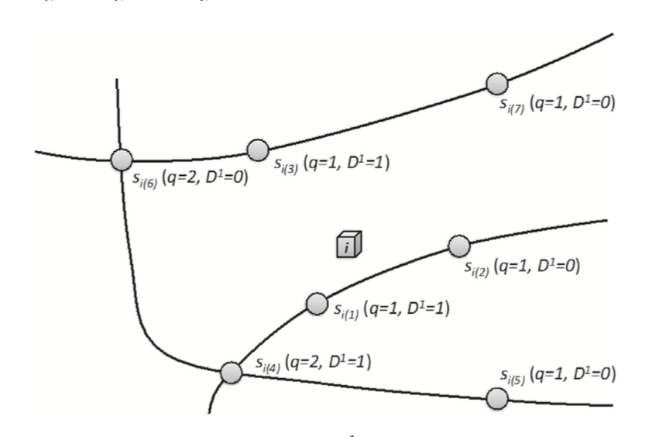
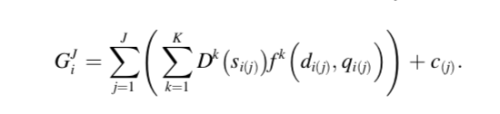
04
Future Work
Currently only use Euclidean distance
Try well-developed accessibility measures
Sadayuki, Taisuke. “Measuring the Spatial Effect of Multiple Sites: An Application to Housing Rent and Public Transportation in Tokyo, Japan.” Regional Science and Urban Economics, vol. 70, 2018, pp. 155–173., doi:10.1016/j.regsciurbeco.2018.03.002.
Notes:
The gravity-based function GJi , which represents a traditional accessibility measure, is a function of diðjÞ, qiðjÞ and DkðsiðjÞÞ for j 1⁄4 f1; 2;...;Jg, where diðjÞ is the distance from housing unit i to siðjÞ, qiðjÞ is a value representing the quantitative characteristics of siðjÞ , Dk ðsiðjÞ Þ is a dummy variable that takes a value of one if siðjÞ is of type k 2 f1; ...Kg. cðjÞ is an intercept of the spatial effect of the jth closest site, and J is the number of the closest sites included in the measure.

Slide 23
Thank you!

